Slide 1
Autonomous Physics-Based Modeling of Retention Loss in 3-D NAND Flash Memory EDL Manuscript Summary Myung Jin

Slide 2
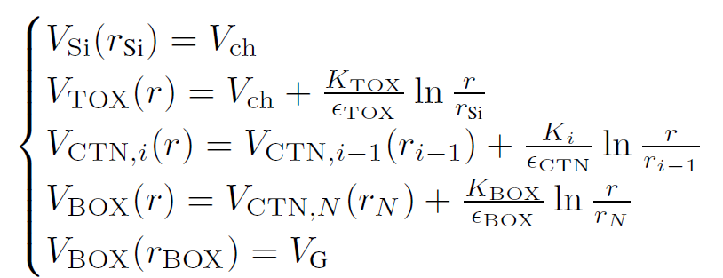
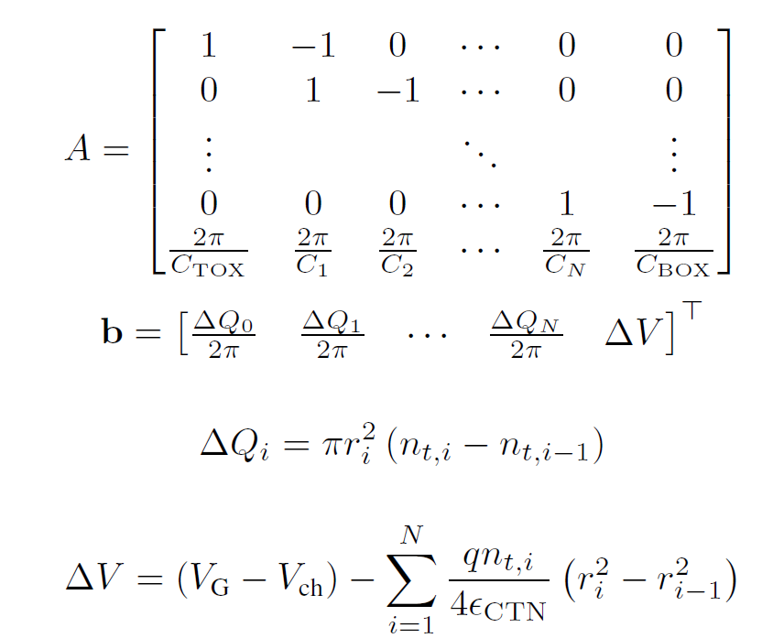


Detailed Poisson Solution
Potential Solution: Poisson equation
Boundary conditions
Solution

Slide 3
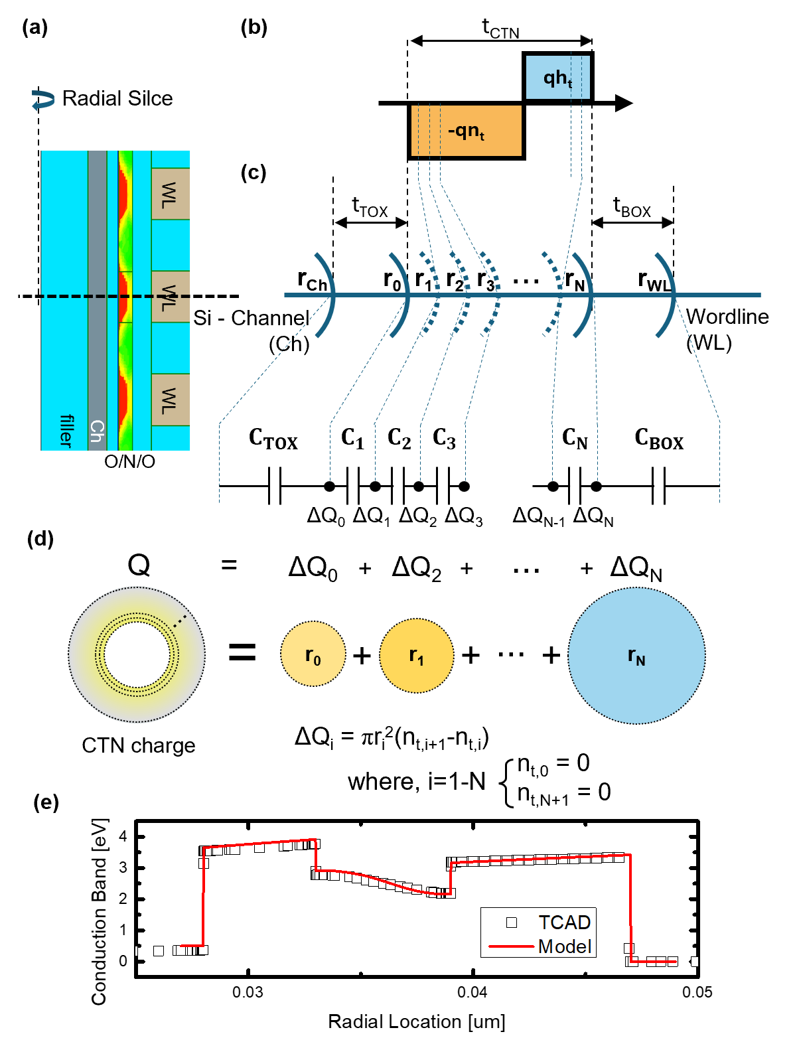
Detailed Poisson Solution
Fig. 1
Radial Slice
pgm charge
cylinder capacitance
charge component
Compatibility to TCAD

Slide 4


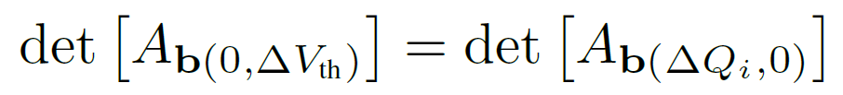
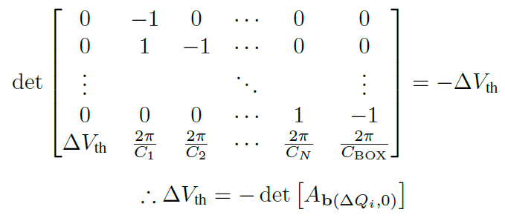
Q-ΔV_{th} Relation
ΔV_{th} : Equivalent channel field intensity
By Cramer’s rule,

Slide 5
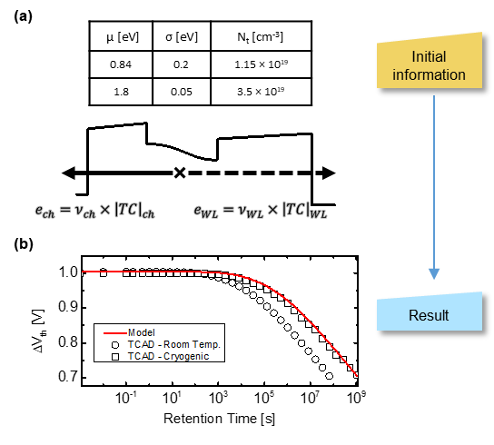
Autonomous Modeling & Result
Fig. 2
Initial information & emission mechanism
model-TCAD match

